Slide 1


Hii,
Iam Siddhika
Welcome to Power BI Series
Part -52

Slide 2



We focus only on the most used and important Dax Functions
Today Content
Meet DAX
I’m soo Excited. It’s my favourite functions.
Are you ready guys?
COMMON FUNCTION CATEGORIES
8.RELATIONSHIP FUNCTIONS(FEW MORE)
USERELATIONSHIP CROSSFILTER

Slide 3


USERELATIONSHIP
The USERELATIONSHIP function in DAX is used to specify a relationship to be used in a calculation. This is particularly useful when there are multiple relationships between tables, but only one is active. You can temporarily activate an inactive relationship within a specific calculation.
Check next
example to
understand
Syntax
USERELATIONSHIP(<columnName1>,<columnName2>)
<column1>: The first column that defines the relationship.
<column2>: The second column that defines the relationship.
Usage: Helpful when you need to use an inactive relationship without changing the data model.
Example: Comparing sales based on different date columns (e.g., OrderDate vs. ShipDate).
By using USERELATIONSHIP, you can effectively manage multiple relationships in your data model to perform accurate and meaningful analyses.

Slide 4
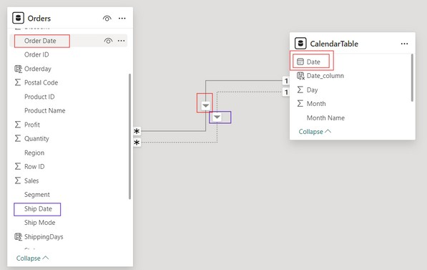


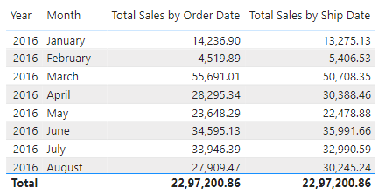

VISUAL EXAMPLE FOR BETTER UNDERSTANDING
Here just i’m taking for example to understand.
we have two tables: Orders and Calendar. The Orders table has two date columns:
OrderDate and ShipDate. We have a relationship between Orders[OrderDate] and Calendar[Date] that is active, and another between Orders[ShipDate] and Calendar[Date] that is inactive.
Let's create two measures that calculates:
Total sales based on OrderDate (using the active relationship)
Total sales based on ShipDate (using the inactive relationship).
2.Total Sales by Ship Date (using the inactive relationship):
1. Total Sales by Order Date (using the active relationship):
got it?
Total Sales by Order Date: This measure uses the active relationship between Orders[OrderDate] and Calendar[Date].
Total Sales by Ship Date: This measure uses the USERELATIONSHIP function to temporarily activate the inactive relationship between Orders[ShipDate] and Calendar[Date] for this calculation.

Slide 5

CROSSFILTER
The CROSSFILTER function can be used to change the filter direction between two related tables or to disable filtering. This is particularly useful when dealing with bi-directional relationships or when you need to adjust the filter context for specific calculations.
Got it? check next example for better
understanding
Syntax
CROSSFILTER(<columnName1>, <columnName2>, <direction>)
columnName1: The name of an existing column, usually from the many side of the relationship.
columnName2: The name of an existing column, usually from the one side of the relationship.
direction: Specifies the cross-filtering direction. Can be None, Both, OneWay, OneWay_LeftFiltersRight, or OneWay_RightFiltersLeft.
Both: Enables bi-directional filtering, where filters on either side affect the other side.
None: Disables filtering between the specified columns.
OneWay: Filters from the one side (lookup side) affect the many side. OneWay_LeftFiltersRight: Filters on the side of columnName1 affect the side of columnName2.
OneWay_RightFiltersLeft: Filters on the side of columnName2 affect the side of columnName1

Slide 6
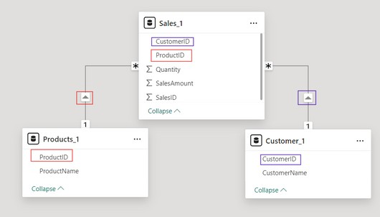

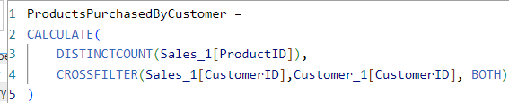
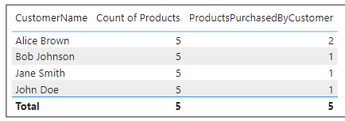
VISUAL EXAMPLE FOR BETTER UNDERSTANDING
I have created 3 tables : Sales_1, Products_1 and Customers_1. check the Relationship and filter direction here.
cleared?
We want know How many products did each customer purchase for each customer?
This measure uses DISTINCTCOUNT to count the unique occurrences of ProductIDs for each customer. The CROSSFILTER function ensures that the relationship between Sales and Customers is considered in both directions.
ProductsPurchasedByCustomer: column correctly reflects the count of distinct products purchased by each customer. By establishing a relationship between the Sales table (containing purchase transactions) and the Customers table, the CROSSFILTER function ensures that only the products associated with each customer are considered. This results in accurate counts of products purchased by each customer, despite the lack of a direct relationship between the Products and Customers tables.
Count of product : The "Count of Products" column doesn't have a direct relationship with the Customers table, so it doesn't filter products based on individual customer transactions. Instead, it simply counts all distinct products in the dataset, regardless of who purchased them. Consequently, this count remains the same for all customers because it's not influenced by customer-specific filters.

Slide 7


Thank you for joining me today to learn about Part -52 of Power BI!
Remember, Learning DAX is key to unlocking the full potential of Power BI for insightful reporting and visualization.
Stay tuned for more insights and tips on Power BI in our next Series.
Follow
Siddhika Shah

